Slide 1

Gopalganj Science and Technology University ,Gopalganj
Electro Solution(E-commerce platform)
Presented By
Supervised by
Name: Md. Anamul Haque
ID: 20CSE029
Session: 2020-21
Department of CSE, GSTU
Name: Md. Ferdous
Lecturer ,
Department of CSE ,GSTU

Slide 2
Project Overview
An online platform for selling and buying electronic devices.
Users Can
Register & login securely.
Browse categories and subcategories products.
View product details (image, price, brand, availability etc)
Filter product dynamically.
Add to cart and via online payment.
View order history.
Admin (Shop Owner) can:
Manage category items(Add ,Delete, Update)
View all buyers, payments history on via dashboard.
Manage member access(admin ,User)

Slide 3
Introduction
Electro Solutions is a modern and user-friendly online shop designed to provide a seamless experience for purchasing electronic products. The platform offers a wide range of gadgets and components, including laptops, desktops, mobile phones, camera accessories, and more. With intuitive navigation, real-time filter, secure checkout, payment gateway, admin dashboard, and responsive design, Electro Solutions aims to be a one-stop destination for tech enthusiasts and general consumers alike.

Slide 4
Features
🔐 Authentication (Firebase)
📄 Admin Dashboard
🧾 Payment Integration (e.g., sslcommerz)
🛍️ Browse Products
📦 View Product Details
🛒 Add to Cart & Checkout
📚 Payment History
📚 Category wise data filtering system.

Slide 5
Technology Stack
Frontend:HTML,React.js,Tailwind CSS
Backend:Node.js, Express.js
Database: MongoDB
Authentication: Firebase
Payment: SSLCommerz
Deployment: Firebase(Frontend),Vercel(Backend),
Tools: Visual Studio Code, Git and GitHub

Slide 6
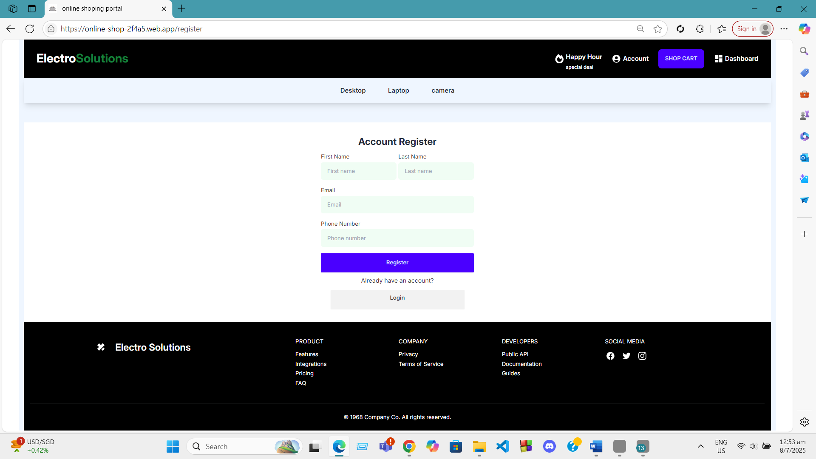
System Workflow(Here some screen sort of running project)

Slide 7
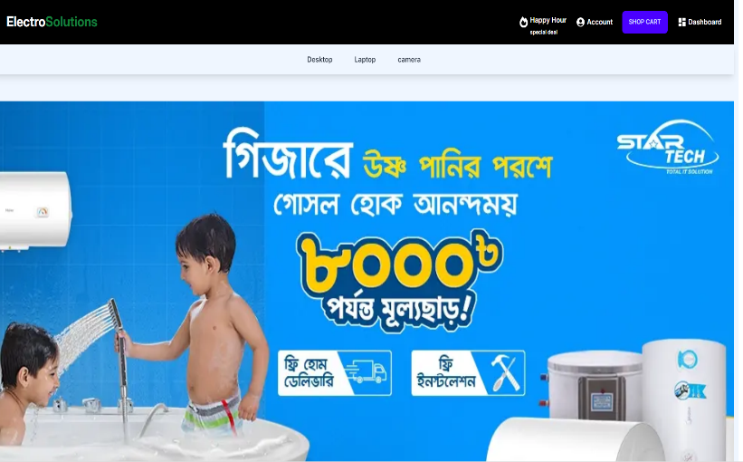
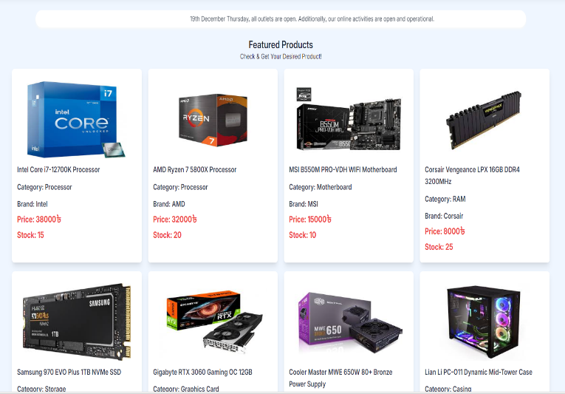
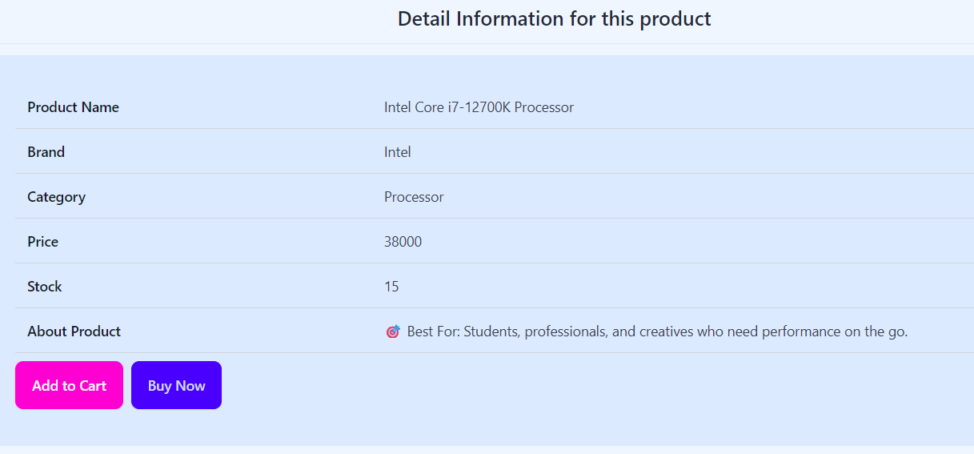
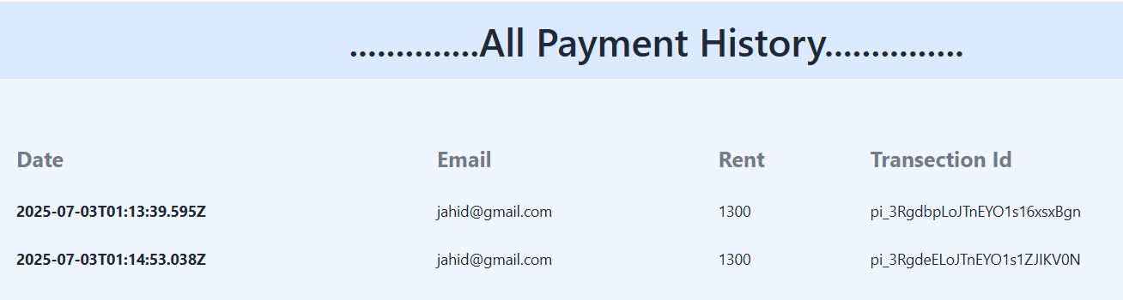
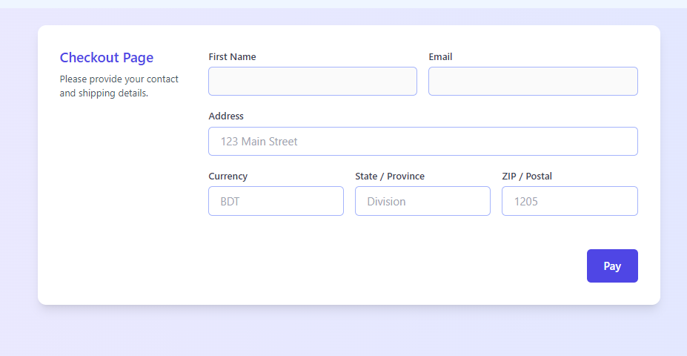
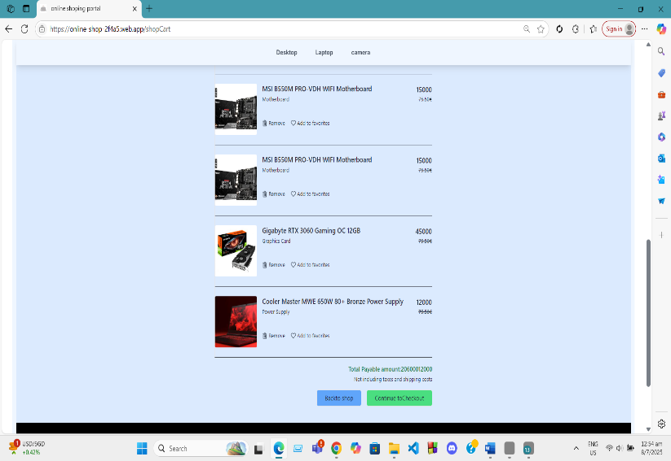
User Interface (System Workflow)

Slide 8
Future Enhancements
AI-Powered Product Recommendations
Live Chat Support
Integrate live customer support or AI chatbot for instant help.
Discount Coupons & Promo Codes
Allow users to apply discount codes during checkout.
Mobile App Version
Email & SMS Notifications
Notify users of order confirmations, shipping updates, and special offers.

Slide 9
Database Structure
Users Collection:
name, email, role (user/admin), etc.
Featured Product Collection:
_id ,name ,category ,brand ,price ,stock status , product image)
Carts Collection:
_id, user-name, user-email , product name ,category ,brand ,price
Payments Collection:
User_Id, total-amount, currency, date, customer address
Category Product Collection:
_id ,category-name ,category ,brand ,price ,stock status , image)

Slide 10
Conclusion
The Electro Solutions project successfully demonstrates the design and development of a modern online electronics store. It offers a smooth and user-friendly shopping experience with features like secure authentication, dynamic product browsing, online payments, and order tracking. The admin panel allows efficient management of products, users, and orders. This project not only showcases key concepts of full-stack web development but also lays the foundation for future enhancements such as AI integration, mobile app support, and real-time inventory tracking to make the platform more robust and scalable.

Slide 11
Thank You

